Slide 1
Firebase Cloud Messaging Service
Implementation of Firebase Cloud Messaging Service using Spring Boot Application

Slide 2
What is Firebase Cloud Messaging Service?
Firebase Cloud Messaging (FCM) is a cross-platform messaging solution that lets you reliably send messages at no cost.
Using FCM, we can notify a client app that new email or other data is available to sync.
We can send notification messages to drive user re-engagement and retention.
For use cases such as instant messaging, a message can transfer a payload of up to 4000 bytes to a client app.

Slide 3
Key Capabilities of Firebase Cloud Messaging Service
Send notification messages or data messages.
Send notification messages that are displayed to your user. Or send data messages and determine completely what happens in your application code.
Versatile message targeting.
Distribute messages to your client app in any of 3 ways—to single devices, to groups of devices, or to devices subscribed to topics.
Send messages from client apps.
Send acknowledgments, chats, and other messages from devices back to your server over FCM’s reliable and battery-efficient connection channel.

Slide 4
How Does FCM works?
An FCM implementation includes two main components for sending and receiving:
A trusted environment such as Cloud Functions for Firebase or an app server on which to build, target, and send messages.
An Apple, Android, or web (JavaScript) client app that receives messages via the corresponding platform-specific transport service.
We can send messages via the Firebase Admin SDK or the FCM Server protocols.We can use the Notification Composer for testing and to send marketing or engagement messages using powerful built-in targeting and analytics or custom imported segments.

Slide 5
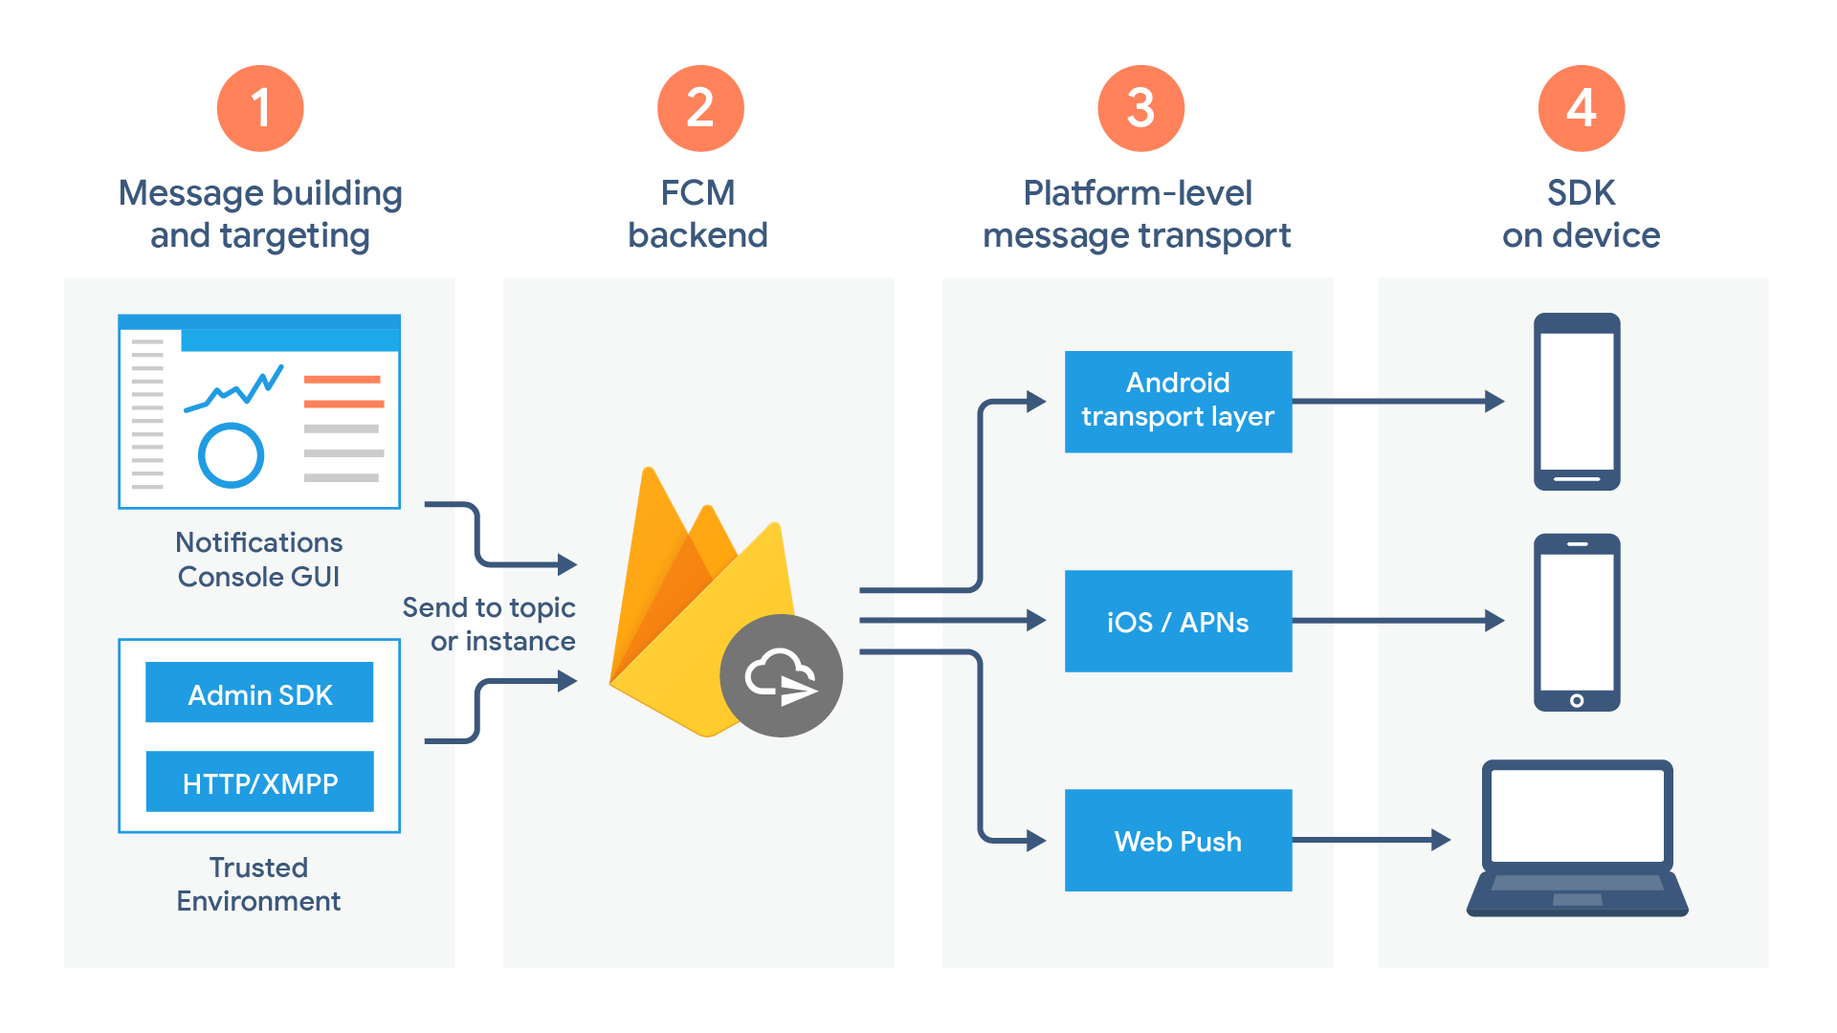
FCM Architectural Overview

Slide 6
Implementation of POC using Firebase Cloud Messaging Service
We have to implement the following steps in order to implement a POC of Firebase Cloud Messaging Service using Spring Boot Application and these are:
Create a Android project in Android Studio and integrating it with Google Firebase project.
Integrating our Android project with Firebase Cloud Messaging Service of Google Firebase project.
Integrating our Android project with Firebase Firestore Service of Google Firebase project.
Creating a Spring Boot Application for Sending Notification
Sending Notification using Azure Notification Hub to a user.

Slide 7
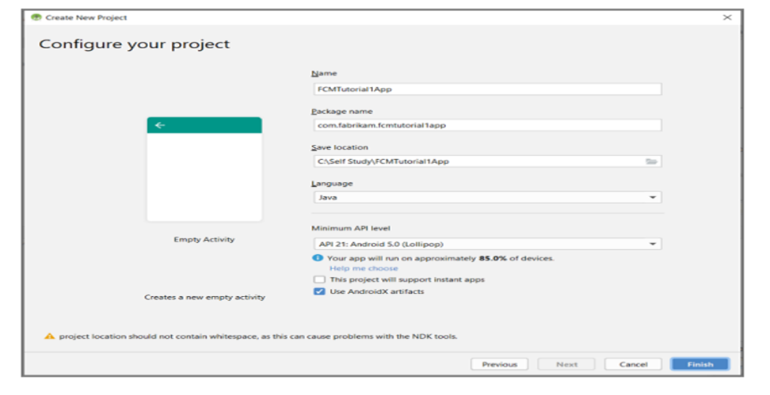
Creating a Android project in Android Studio and integrating it with Google Firebase Project
Creating a Android project in Android Studio and integrating it with Google Firebase Project

Slide 8
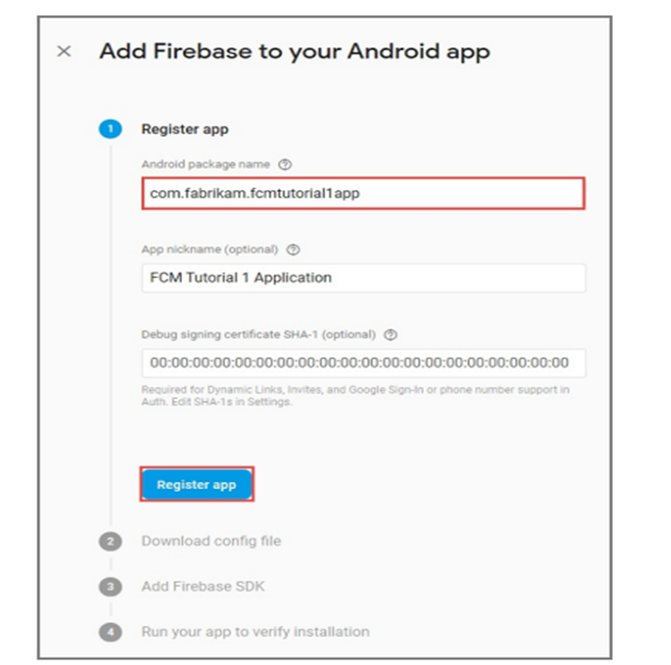
2. Create a Firebase project that supports FCM is shown in below snippet:

Slide 9
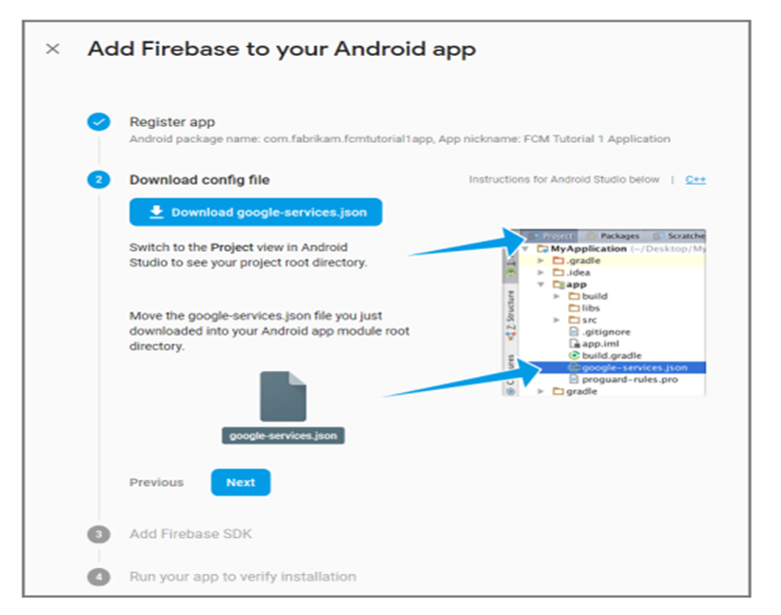
3. Integrating FCM project with our Android Studio Project by adding the google-services.json file in the root directory of our Android Studio Project is shown in snippet below:

Slide 10
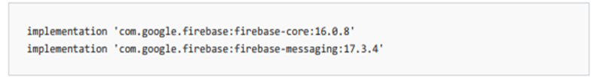
Integrating Android project with Firebase Cloud Messaging Service
In the build.gradle file for the app,add the following lines in the dependencies section:
Add the following line to the end of the app-level build.gradle file after the dependencies section:

Slide 11

Integrating Android project with Firebase Firestore Database Service
Add Firebase Firestore Database libraries. In the Build.Gradle file for the app,add the following lines in the dependencies section
Add the following dependencies for more Firebase functionalities

Slide 12
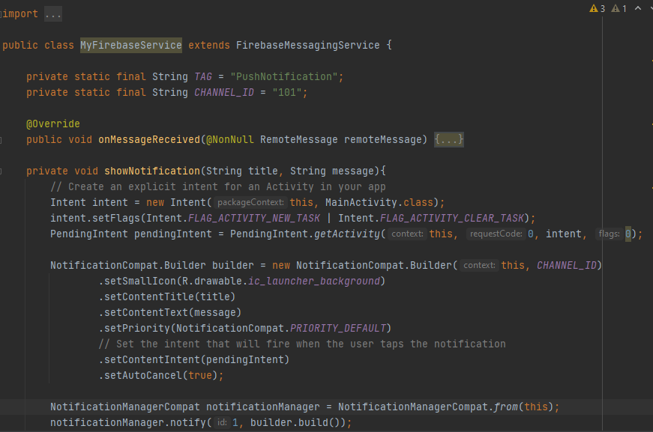
Android Application for Receiving Push Notifications
Create a Listener class for receiving Push Notifications

Slide 13
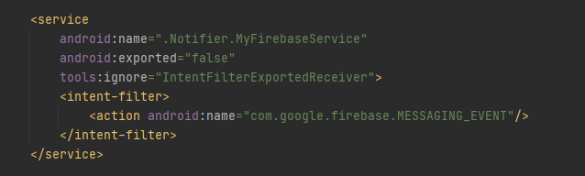

2. Update the Android Manifest.xml file
3. Add the following necessary FCM-related permissions below the <application> tag.

Slide 14
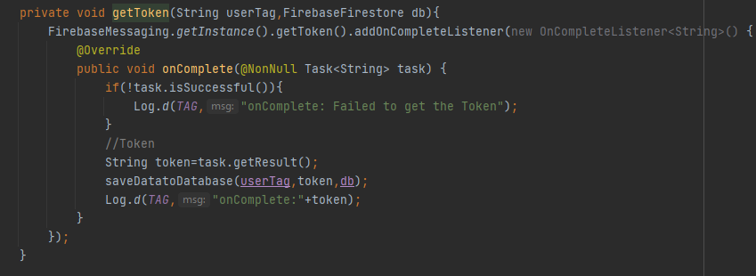
4. Fetching token from Firebase Cloud Messaging Service in MainActivity class is shown in the following below snippet:

Slide 15
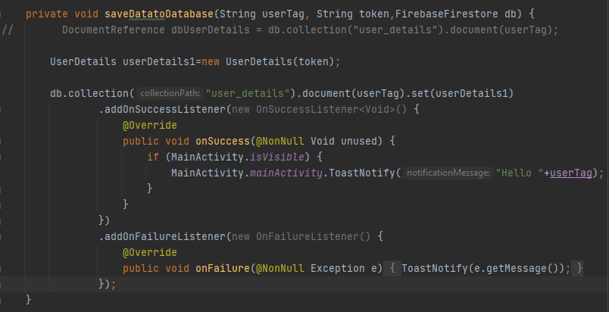
5. Saving the fetched token from FCM in Firebase Firestore database using user name is shown in the following below snippet:

Slide 16
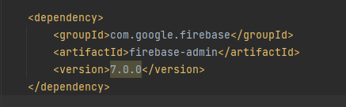
Creating a Spring Boot Application for Sending Notification
1.Creating a Spring boot Application in Spring Tool Suite/IntelliJ.
2.Add the following maven dependency in pom.xml file of the project is shown in the below snippet:

Slide 17
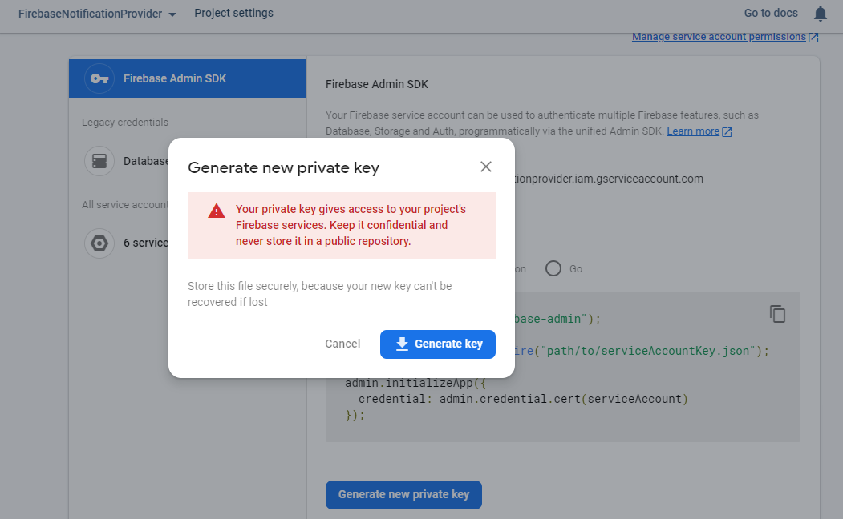
3. Adding Firebase project credentials to our Spring Boot Application is shown in the following snippet below:

Slide 18
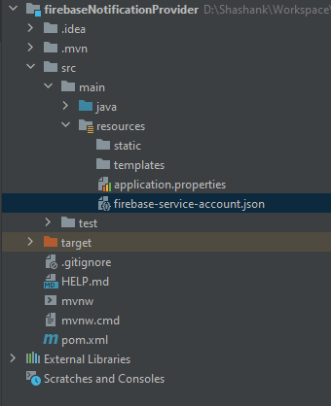
4. Adding firebase-service-account.json file in the resources directory of our Spring Boot application:

Slide 19
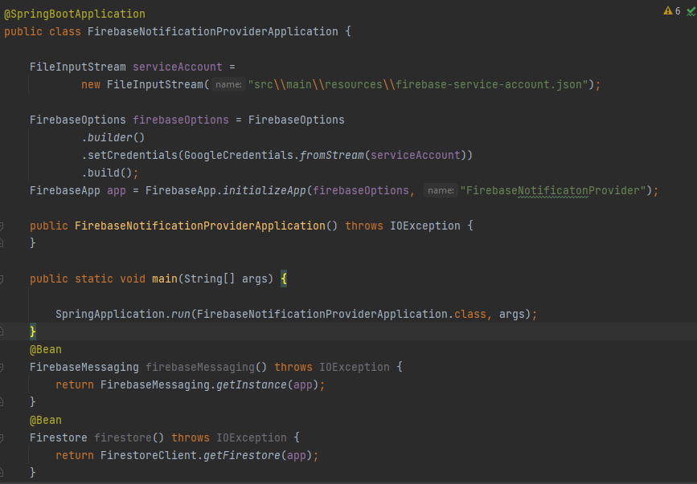
5. Creating a Firebase Messaging bean and Firebase Firestore database bean is shown in the following snippet below:

Slide 20
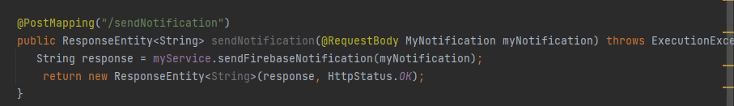
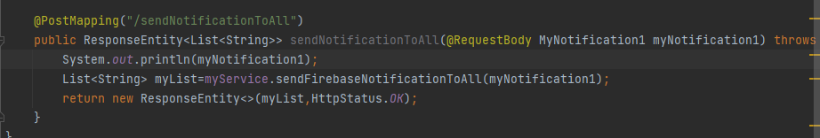
6. Creating a end point for handling the Notification send request to a single user is shown in below snippet:
7. Creating a end point for handling the Notification send request to a list of users is shown in below snippet:

Slide 21
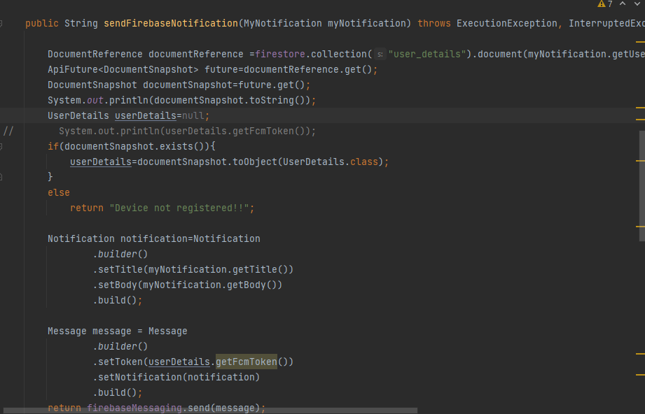
8. Sending Notification body to Firebase Cloud Messaging Service to single user from service layer of Spring boot Application is shown in below snippet:

Slide 22
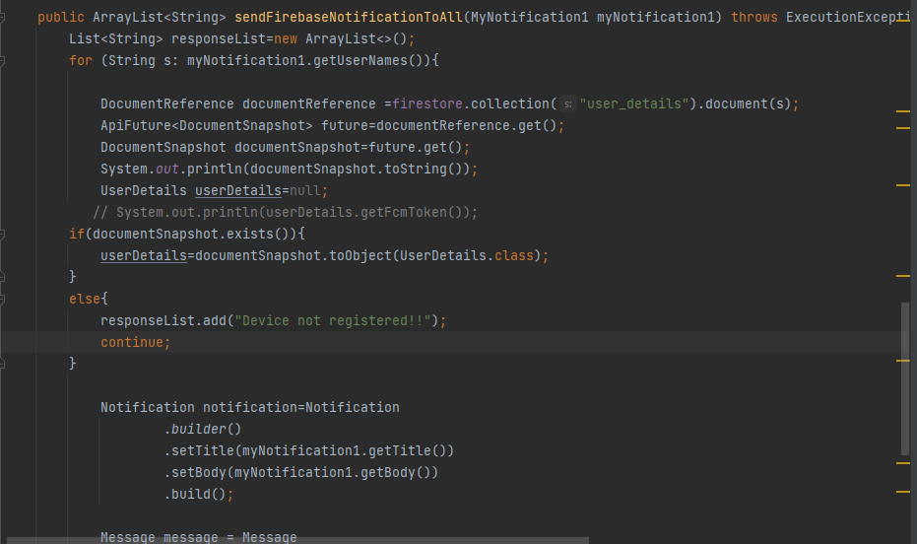
9. Sending Notification body to Firebase Cloud Messaging Service to multiple users from service layer of Spring boot Application is shown in below snippet:

Slide 23
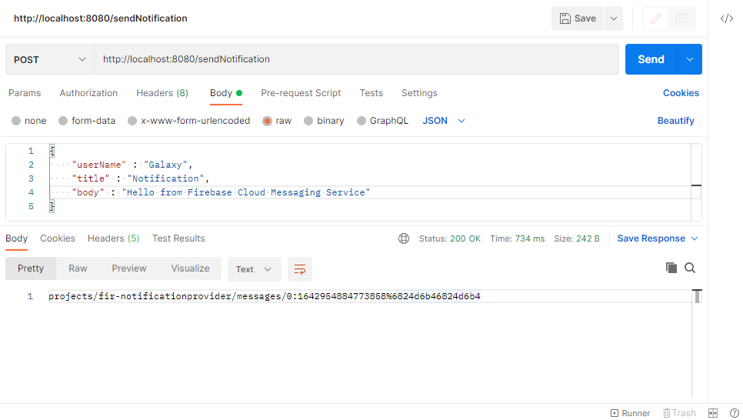
Sending Notification to User
1. Sending Notification to single Android Device using Spring Boot Application is shown in below snippet:

Slide 24
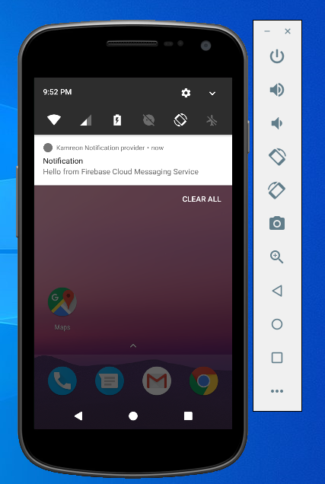
2. Notification Received by Android Devices is shown in below snippet:

Slide 25
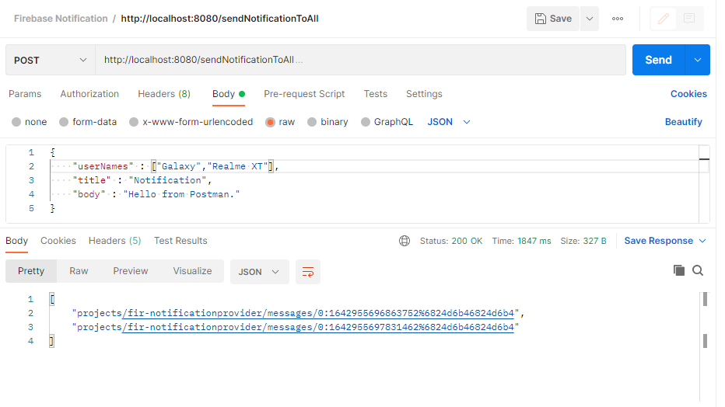
3. Sending Notification to multiple Android Devices using Spring Boot Application is shown in below snippet:

Slide 26
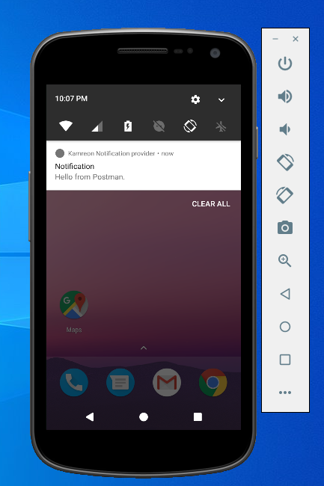
4. Receiving Notifications in Android Devices is shown below:

Slide 27
References
https://firebase.google.com/docs
https://firebase.google.com/docs/cloud-messaging

Slide 28
Thank You.

